Slide 1
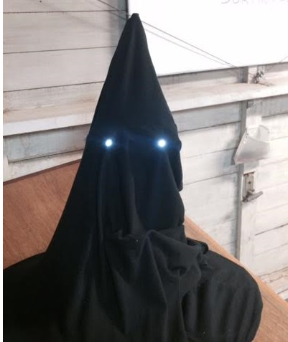
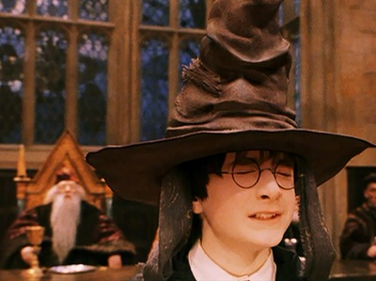
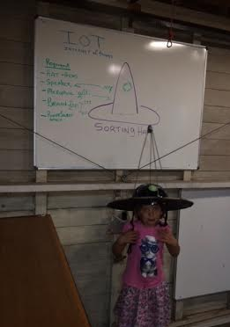

THE IDEA: BUILD A HARRY POTTER SORTING HAT

Slide 2

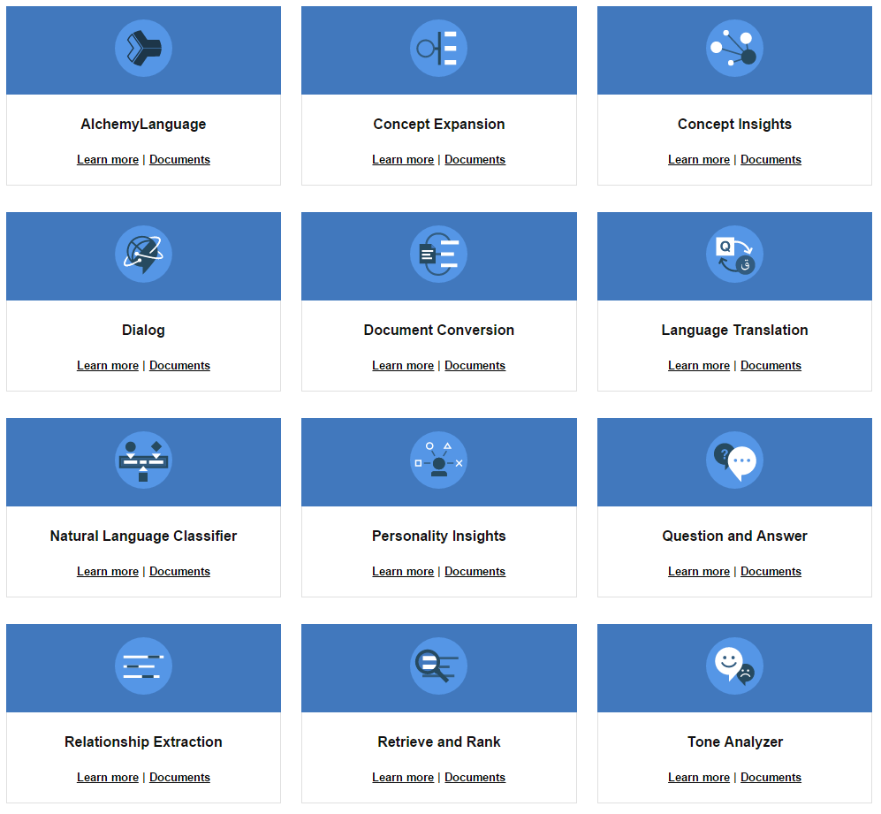

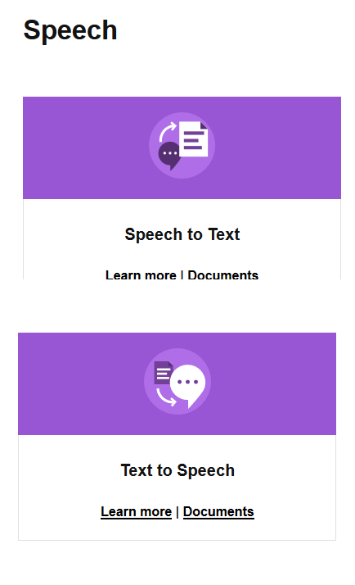
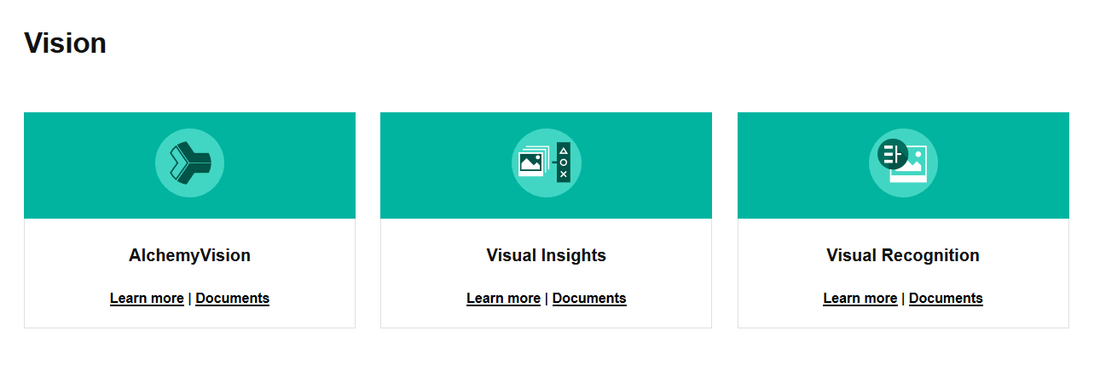
We used 2 Cognitive Computing Services
Speech to Text
Natural Language Classifier (NLC)
Bluemix Cloud platform Free 30 day trial
http://www.ibm.com/smarterplanet/us/en/ibmwatson/developercloud/

Slide 3
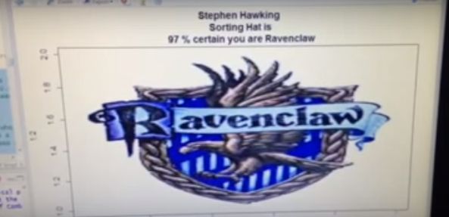
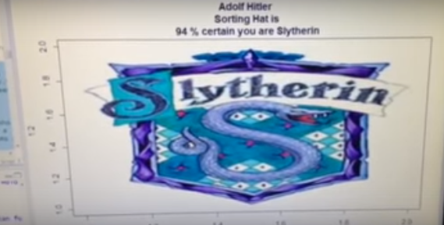
Stephen Hawking is Ravenclaw; Hitler is Slytherin

Slide 4
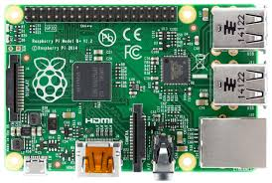
Raspberry PI AI/Cognitive Computing/NLC/APIs SERVOS + Arduino HARRY Potter Speech to Text

Slide 5
Things we might want to hack together (?)
Robotic Mouth to Talk
(Arduino +Transistor)
Robotic Eyes to Blink/Color
(Arduino + LEDs)
Audio Speech to Text API - STT (Watson APIs)
Text to Speech API (English accent?) (Watson APIs)
JK Rowling 3D Printed Face? (3-D_Printing)
Natural Language Classifier = Brain to Sort (IBM Watson Logic)
Portable: Chassis, Power & Sort Trigger
Curate Audio and Web Page (?) Wand

Slide 6
The wave of the future is not the conquest of the world by a single dogmatic creed but the liberation of the diverse energies of free nations and free men
John F Kennedy

